Slide 1
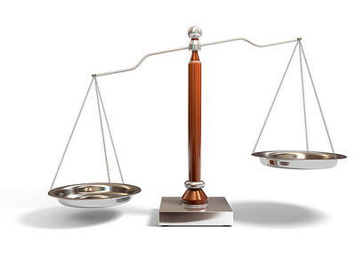
Mill I: Liberty and Utility
Politics 2A
Dr Carl Knight, Lecturer in Political Theory

Slide 2
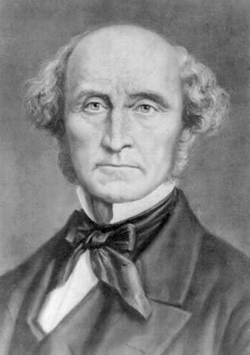
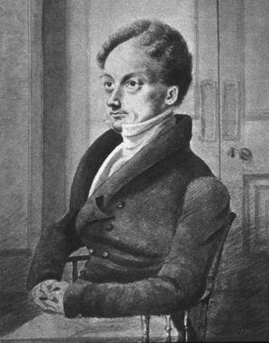
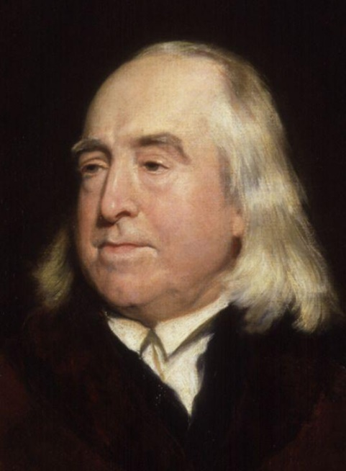
JOHN STUART MILL (1806-73)
Son of James Mill, Scottish economist & disciple of Jeremy Bentham, founder of utilitarianism
James Mill and Bentham decided to raise J. S. to become a great utilitarian (philosophy, history, econ)
Greek at 3, Latin at 8, but nervous breakdown at 20
At odds with his reputation as leading voice of liberalism, spent 35 years at East India Company

Slide 3
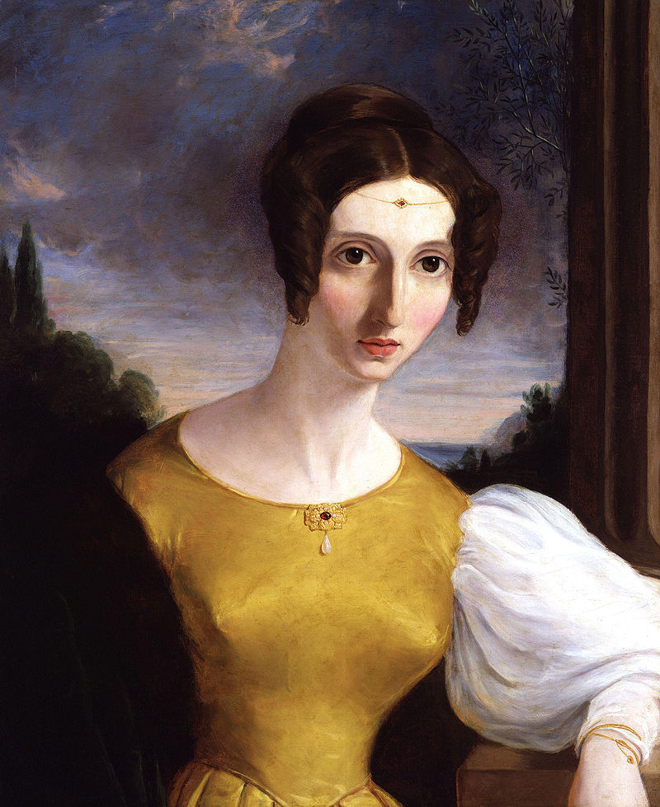
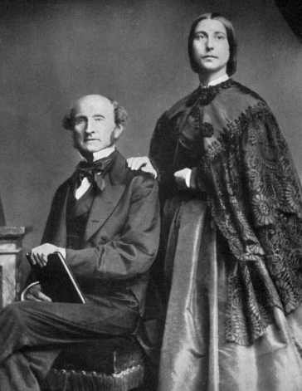
LATER LIFE
Dominant figure in late C19th British intellectual life
1865-68 Lib. MP – campaigned for women’s suffrage
In 1851 married Harriet Taylor after two decades of intense friendship.
Harriet died in 1858, and Mill worked with her daughter, Helen Taylor, for last 15 years of his life

Slide 4

WORKS
System of Logic (1843)
Principles of Political Economy (1848)
On Liberty (1859)
Utilitarianism (1861)
Considerations on Representative Government (1861)
The Subjection of Women (1869)

Slide 5
CIVIL LIBERTY
Starts On Liberty by saying that focus is ‘Civil, or Social Liberty: the nature and limits of the power which can be legitimately exercised by society over the individual’ (5)
Defines civil liberty as freedom from society’s power, not just as freedom from governmental power
Groups of private individuals can infringe liberty

Slide 6
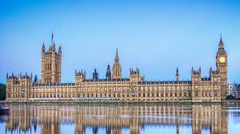
LIBERTY AND GOVERNMENT
Traditional view: ‘By liberty was meant protection against the tyranny of political rulers’ (5)
Hence, 2 constraints on govt: (1) immunities or ‘political liberties’; (2) later, govt’s acts subject to consent of body representing community interests
But later still the idea of government separate from subjects replaced with elective government

Slide 7
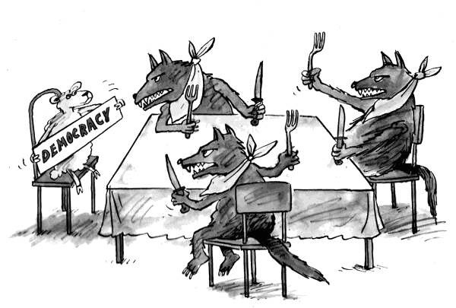
TYRANNY OF THE MAJORITY
Constraints on government started to be viewed as unnecessary: ‘nation did not need to be protected against its own will. There was no fear of it tyrannizing over itself’ (7).
But in democracy there’s a new tyranny: ‘tyranny of the majority’ (de Tocqueville).
Each is ruled by others, not themselves

Slide 8
SOCIETY AS TYRANT
Govt is not only tyrant: ‘society is itself the tyrant’ (8)
People must be protected against prevalent opinions, which may force ideas & practices on them
‘There is a limit to the legitimate interference of collective opinion with individual independence’ (9)
Hobbes: protect individual with political power. Locke: protect individual against political power. Rousseau, Marx: claim political power for the people. Mill: protect individual against the people.

Slide 9
PRINCIPLE OF LIBERTY (‘HARM PRINCIPLE’)
Custom doesn’t reliably protect; we need a principle:
‘the only purpose for which power can be rightfully exercised over any member of a civilized community, against his will, is to prevent harm to others’ (14)
Can try to reason with others but mustn’t infringe their liberty for their own good.
‘Over himself, over his own body and mind, the individual is sovereign’ (14)

Slide 10

SCOPE OF THE PRINCIPLE OF LIBERTY
Power my be exerted over Children, young persons, ‘those backward states of society in which the race itself may be considered in its nonage’ (14)
Benevolent despotism acceptable for ‘barbarians’ (!)
Those ‘capable of being improved by free and equal discussion’ mustn’t be forced but to protect others.

Slide 11
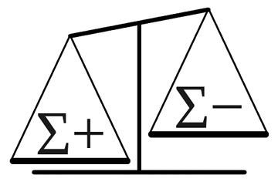
PRINCIPLE OF UTILITY
Principle of liberty is supposed to be consistent with Mill’s ultimate principle as a utilitarian: ‘principle of utility’:
‘actions are right in proportion as they tend to promote happiness, wrong as they tend to produce the reverse of happiness. By happiness is intended pleasure, and the absence of pain; by unhappiness, pain, and the privation of pleasure’ (Utilitarianism, 137).

Slide 12

CONFLICTING PRINCIPLES?
The principle of liberty says a man ‘cannot rightfully be compelled to do or forbear… because it will make him happier’ (14). How is this compatible with utility?
Coercion may seem like it will promote utility, but it actually won’t: ‘I regard utility as the ultimate appeal on all ethical questions; but it must be utility in the largest sense, grounded on the permanent interests of man as a progressive being’ (15).

Slide 13
THE ART OF LIFE
This is underpinned by Mill’s System of Logic, which depicts maxims collectively forming an ‘Art of Life’
Each art is ‘a joint result of the laws of nature disclosed by science, and of the general principles of what has been called Teleology’
‘the promotion of happiness is the ultimate principle of Teleology’
This looks ‘indirect utilitarian’ - (1) Happiness is ultimate goal, (2) this best achieved by following maxims, e.g. (3) the principle of liberty (Lyons 1994)

Slide 14
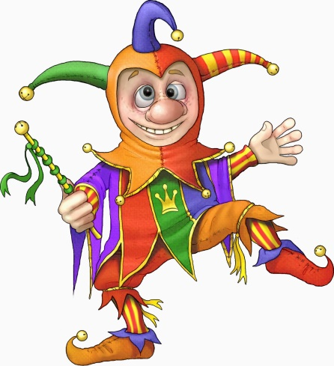
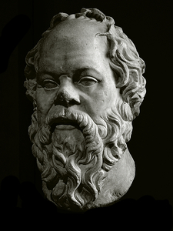
HIGHER AND LOWER PLEASURES
But why think the liberty principle promotes utility? Here we first have to look at Mill’s theory of utility.
Bentham: utility=any pleasurable mental state
Mill: higher versus lower pleasures - ‘better to be Socrates dissatisfied than a fool satisfied’ (Util. 140)
Higher pleasures are those preferred by people with experience of both, and involve ‘higher faculties’
Mill believes history has shown that principle of liberty promotes the more intellectual pleasures

Slide 15

ACTIVITY
Are the principles of liberty and utility compatible?
You may wish to discuss Mill’s arguments about:
The tyranny of the majority
Principle of liberty (or ‘harm principle’)
Principle of utility (‘greatest happiness principle’)
The Art of Life, maxims and indirect utilitarianism
Higher and lower pleasures

Slide 16
LIBERTY OF THOUGHT AND DISCUSSION
Ch. 2: Widely accepted that freedom of press is defence against tyrannical government. Less accepted: freedom of expression furthers human improvement.
All of mankind minus one has no more right to silence one person than that person has to silence them all. Seems anti-utilitarian (cost-benefit).
But ‘the peculiar evil of silencing the expression of an opinion is, that it is robbing the human race’ (21)

Slide 17

ARGUMENTS FOR LIBERTY OF DISCUSSION
Dissenting voice might be right as is often the case.
Even if wrong ensures truth isn’t ‘dead dogma’
Truths understood and acted on when challenged
Truth often lies between extremes (Aristotle), so even if dissent is mistaken it may bring society closer to truth: e.g. C18th society awe of Enlightenment progress corrected by Rousseau

Slide 18
INDIVIDUALITY
Ch. 3: Actions more often subject to constraint as more likely to harm, but free where others not involved
People should be prepared to make informed, personal decisions about how to live
Benefits of acting ‘spontaneously’ (i.e. not custom)
Others’ experience narrow or misinterpreted
Others may not account for character differences
Perception/judgment built through own choices

Slide 19

EXPERIMENTS OF LIVING
‘Experiments of living’ may uncover valuable new truths for all
But must be free to innovate: ‘Genius can only breathe freely in an atmosphere of freedom’ (72).
This absent in China, once far more advanced than Europe, but stagnated by ‘despotism of custom’ (78)
Not just for geniuses: a person’s ‘own mode of laying out his existence is the best, not because it is the best in itself, but because it is his own mode’ (75)

Slide 20

AUTHORITY OF SOCIETY AND INDIVIDUAL
In Ch. 4 Mill argues that society and the individual should control those parts of human life over which they have particular interest (cf. Locke)
Easy case: ‘there is no parity between the feeling of a person for his own opinion, and the feeling of another who is offended at his holding it; no more than between the desire of a thief to take a purse, and the desire of the right holder to keep it’ (93).

Slide 21
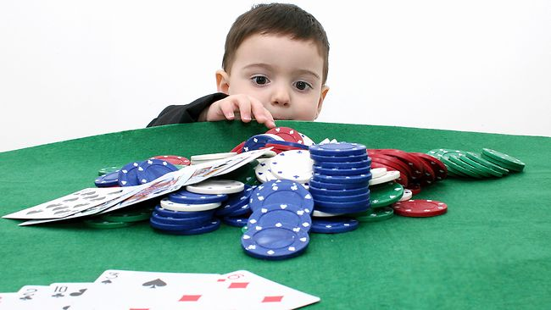
OBLIGATIONS
An obvious objection to Mill’s view is that (almost) all individual action affects society, so society seems to have an interest in all individual action
Mill’s response is that an action is ‘taken out of the self-regarding class’ when it ‘violate[s] a distinct and assignable obligation’ (90).
E.g. someone whose gambling will make them unable to pay debts, or unable to support their family.

Slide 22

CONSENT
‘society … has, if any, only an indirect interest’ over conduct that ‘affect[s] others, only with their free, voluntary, & undeceived consent & participation’ (16)
Consenting to an action makes it relevantly similar to one’s own action - covered by principle of liberty
Confusingly, he says polygamy is contrary to the principle of liberty, yet involving consent by women
Nevertheless may reduce severity of the breach of the principle as he says there is no reason to interfere with Mormon way of life in Utah

Slide 23

FURTHER OBLIGATIONS
Ch. 5 - one does not only have obligations one has expressly consented to
‘There are also many positive acts for the benefit of others, which he may be rightfully compelled to perform’ including ‘to bear his fair share in the common defence, or any other joint work necessary to the interest of the society of which he enjoys the protection’ (15)

Slide 24
CENSURE
If individuals harm others without violating legal rights they may legitimately be subject to negative opinion. Hence, opinion serves principle of liberty.
While we may recommend the full use of faculties to an individual, we can’t force it upon them since well-being is a matter of individual concern
May not deliberately punish persons for their flaws, even through deliberate expression of opinion. The only permissible punishments are the ‘spontaneous consequences’ – ‘lowered in the opinion of others’.

Slide 25
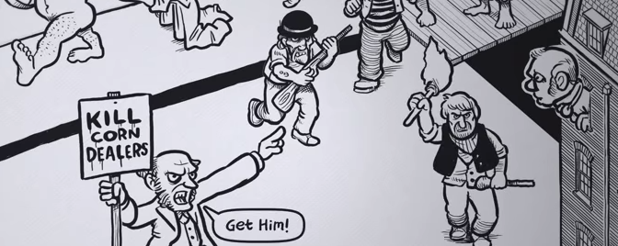
INCITEMENT
Even opinions may be restrained where they amount to instigation to harm. For example, one can say that corn-dealers starve the poor in the press, but can’t shout the same thing to a mob outside a corn-dealer’s house (62).

Slide 26
IMPLICATIONS
Harm to others is in fact legitimate where there is a clear benefit to society as a whole, e.g. where a competitive job market is underpinned by the better candidates getting jobs over the worse candidates Such ‘harm’ presumably does not violate obligations
Poison, alcohol, gambling and prostitution permitted but subject to regulation
But mustn’t leave children uneducated, have kids they can’t support, or be idle – harsh on poor?

Slide 27
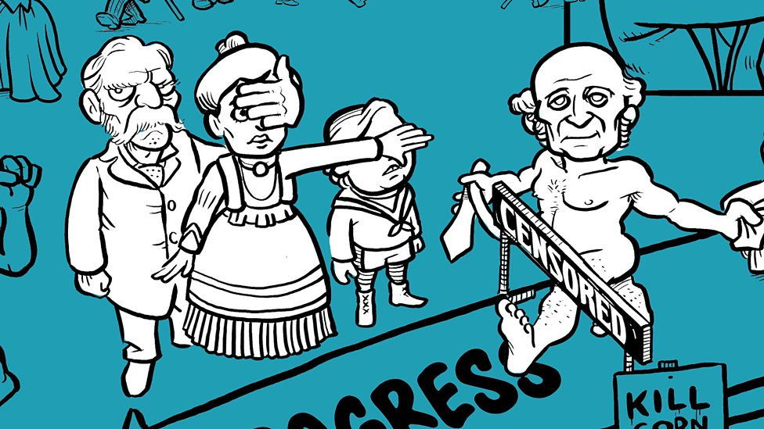
INDECENCY
Prohibits mysterious ‘offences against decency; on which it is unnecessary to dwell’ (109). He means only in public, but still strange he is so vague on this point. Recall defence of spontaneity as a public act and ‘atmosphere of freedom’.

Slide 28
SMALL GOVERNMENT
Individual action is usually better than government action even if government wouldn’t violate liberty:
Individual usually achieves ends best
aids personal development (e.g. jury trial)
barrier to excessive governmental influence on life:
‘If all the roads, the railways, the insurance offices, the great joint-stock companies, the universities, and the public charities were all of them branches of government … not all the freedom of the press and popular constitution of the legislature would make this or any other country free otherwise than in name’

Slide 29

Next Lecture: Representative Democracy and Gender Equality

